Slide 1

Auto Insurance Retention
Eli Miranda

Slide 2

The Insurance Cost Conundrum
Problem
Auto Insurance carriers are always working ways to capture new costumers and struggle to retain existing customers. Inefficiencies in customer retention results in increased costs for carriers.
Solution
I will mitigate this cost by developing machine learning model(s) that will identify the likelihood of customer churn based on aspects of their demographic.
Impact
Consumer retention
Decrease need for marketing
Savings passed to customers
Achieve a significant 4% reduction in your annual premium costs for Americans!

Slide 3

Dataset & EDA
sdfsfsd
Dataset
In-Depth EDA & Modeling
Data is generated
All my data is limited to 1 state (Texas)
My marital status data is limited to single or married
No data for customers that rent their homes
There are multiple home market value ranges for a given city
Churn is imbalanced
Distribution of customers by age is relatively normal except at age 55
Nonsense values in ‘length of residence’ columns
Many columns have weak or no correlation

Slide 4
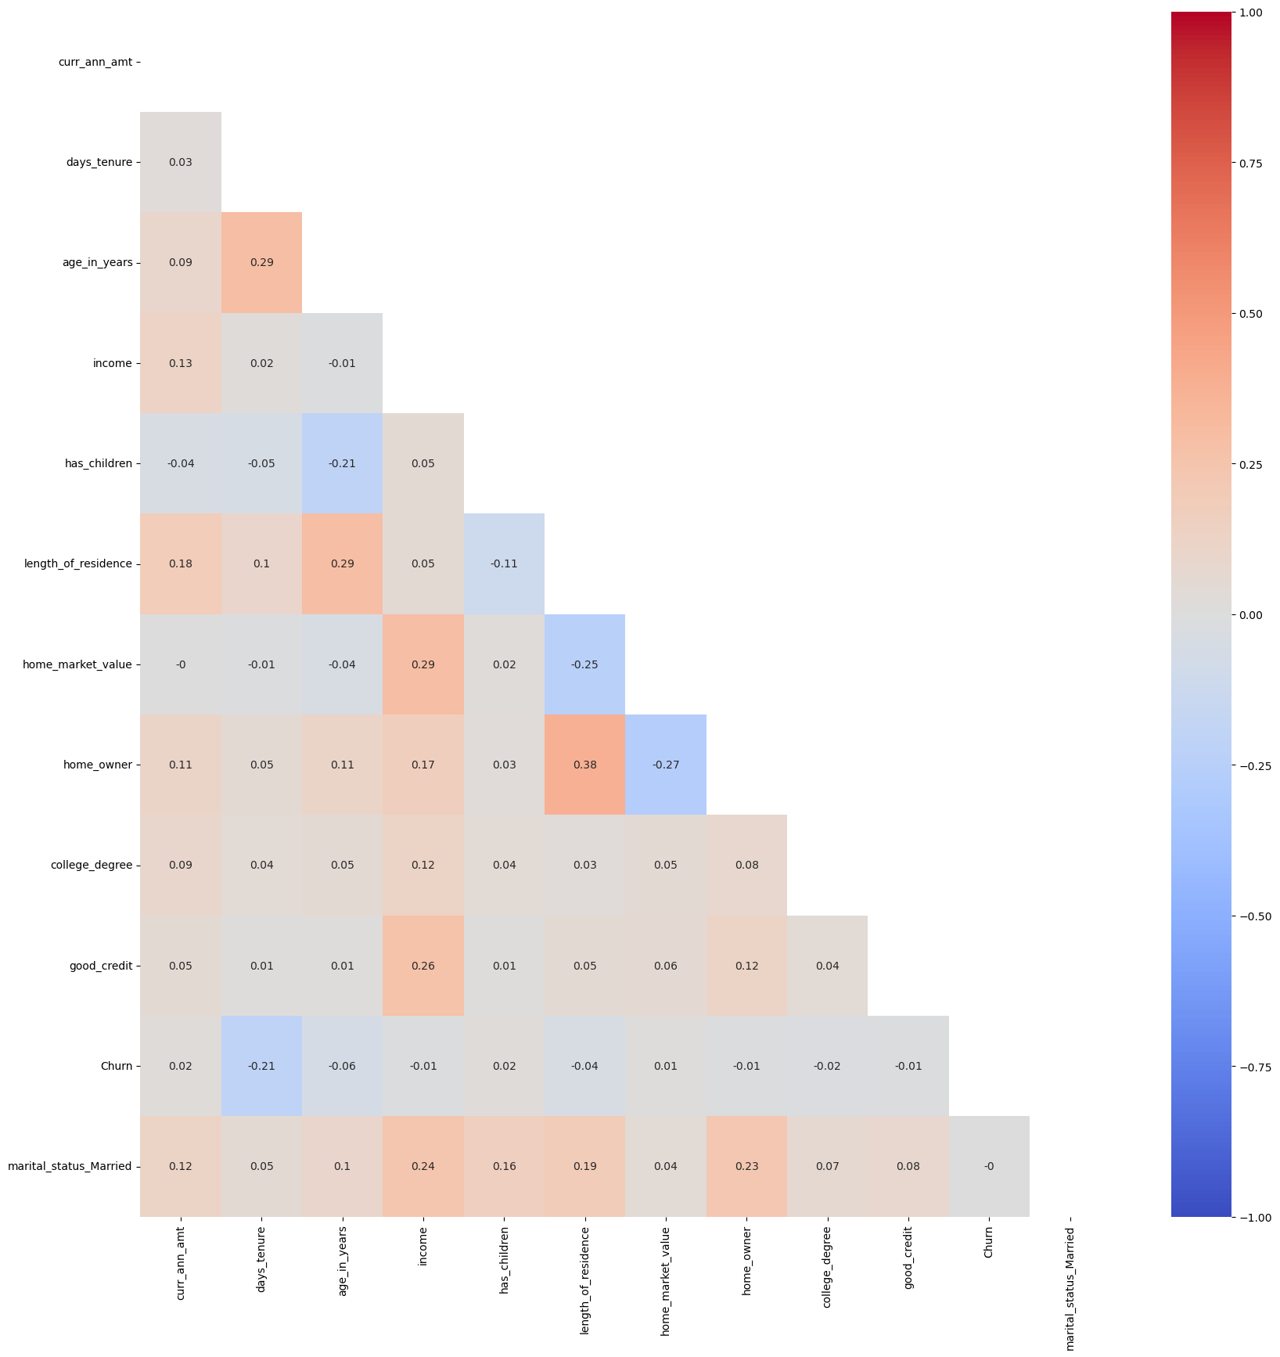
Data Processing
Heatmap of entire Dataframe
Drop columns and rows that do not have any business value and/or negatively impact the performance of models
Ex. Columns with high multicollinearity
The Dataframe is much smaller as columns that hindered model performance were dropped

Slide 5
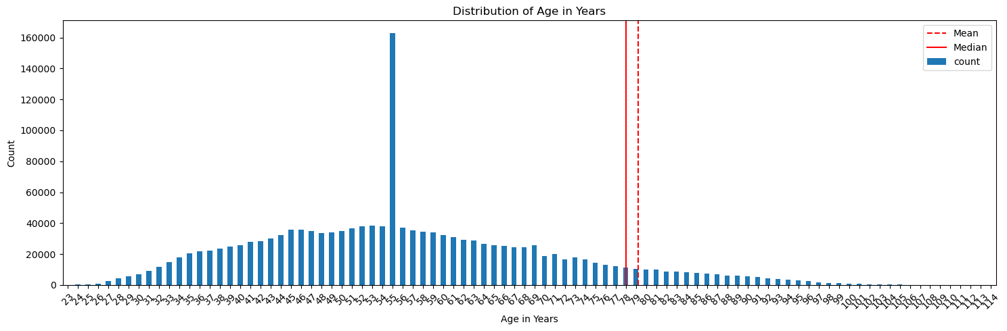
Feature Engineering
Convert categorical columns to numerical columns (Get dummies)
Consolidate large distributions
UPDATE: Did not do this as it negatively impacted model performance
Ex.
Age_in years
Age 55 is an outliar
Ages above 100 are pulling the mean and median right

Slide 6

Baseline Modelling
Logistic Models
XG Boost
Decision Trees
Train Score: 30.87%
Test Score: 30.09%
Low Accuracy
Mean Squared Error: 5111814.5000
R^2 Score: 0.0646
The model does not fit this data.
Mean cross-validation score: 11.77%
Low Accuracy

Slide 7

Preprocessing Approach
Sampling Technique
Rerun Baseline Models
Hyperparameter tuning
Need for a data imbalance
Tested SMOTE, ADASYN & SMOOTEN
SMOOTEN was most effective
Logistic Regression
XG Boost – Best scores
Decision Tree
Utilized pipeline
GridSearchCV
RandomizedSearchCV - Only used during troubleshooting.

Slide 8
Resampled Optimization & Modelling
Logistic Model
XG Boost
w/o Tuning
Decision Tree
KNN
Train Score: 67.92%
Test Score: 62.44%
Better but still low Accuracy
Train Score: 92.50%
Test Score: 87.49%
Best scores but low ROC AUC at 69%
Train Score: 89.71%
Test Score: 68.84%
Overfit
Train Score: 89.72%
Test Score: 66.68%
Overfit

Slide 9
Next Steps
feature engineering
Additional Models & Sampling techniques
Continue Model tuning
Collect more and broader Churn data
Experiment more with features
Add / drop combinations of features
Random Forest
Support Vector Machines
Explore more techniques to address the data imbalance
Utilize pipeline
GridSearchCV
RandomizedSearchCV
Ensemble

Slide 10

Dashboard Demo

Slide 11
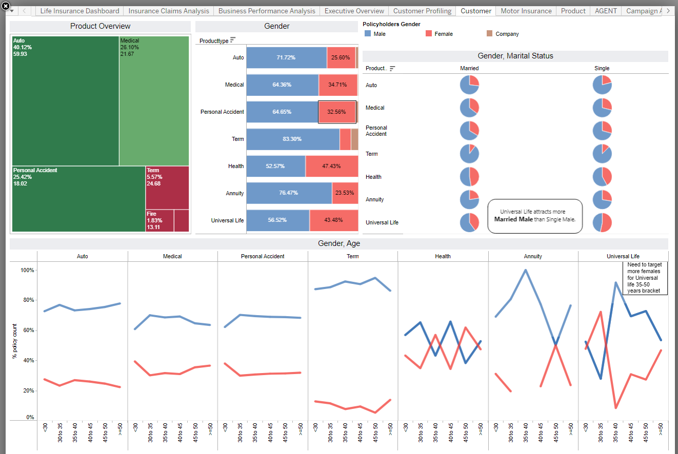

Slide 12

Thank You
Eli Miranda
Auto Insurance Retention Github
Dataset Source
Dashboard Design Source

